Slide 1
Name: Sharmin Akter ID: 2137620128 Department of CSE Course Title:Technical Writing and Presentation Course Code:CSE2242

Slide 2

Human Computer Interaction(HCI)
Enhancing User Experience in the Digital Age

Slide 3
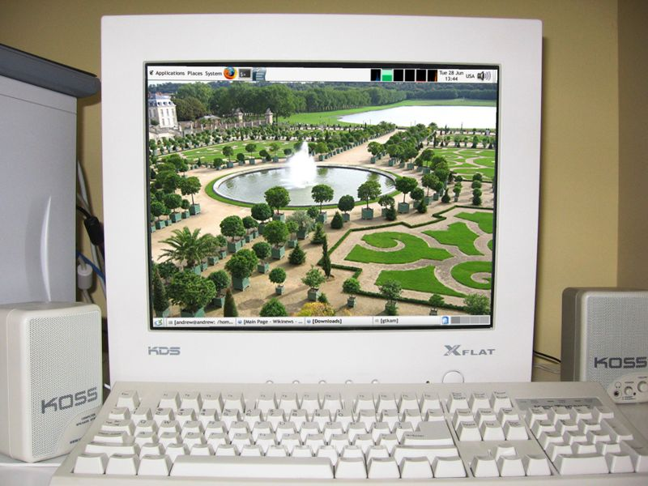
Introduction to HCI
Definition of HCI
The study of how people interact with computers and to what extent computers are developed for successful interaction with human beings.
Example:
A computer monitor provides a visual interface between the machine and the user.

Slide 4

The historical development of HCI
1940s-1950s: Early computing, punch cards, and command lines.
1960s-1970s: GUIs debut with Sketchpad and Xerox PARC's Alto.
1980s: Macintosh and Windows popularize GUIs; Don Norman promotes user-centered design.
1990s-2000s: Web usability and mobile HCI rise with smartphones.
2010s-Present: HCI expands to AR, VR, wearables, and AI-driven interfaces, focusing on human-centric design.

Slide 5
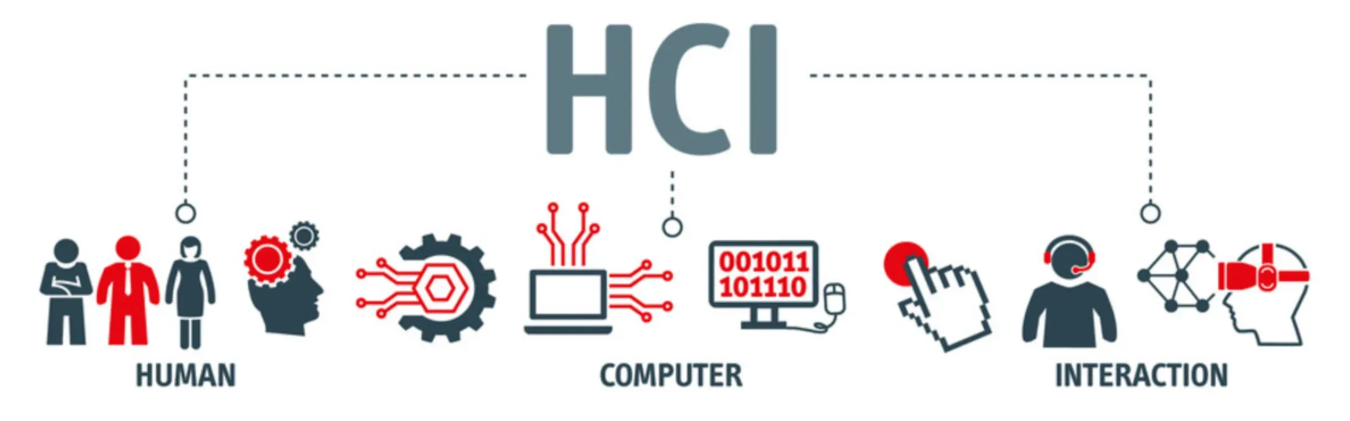
Principles of HCI
5 Major key Principle of HCI
1. User-Centered Design (UCD)
2. Ease of Use
3. Feedback and Response Time
4. Consistency
5. Accessibility

Slide 6
HCI is an Interdisciplinary Field
Ergonomics
Ergonomics
Computer Science
Ergonomics
Artificial Intelligence
Engineering
HCL
Linguistics
Design
Philosophy
Anthropology
Sociology

Slide 7
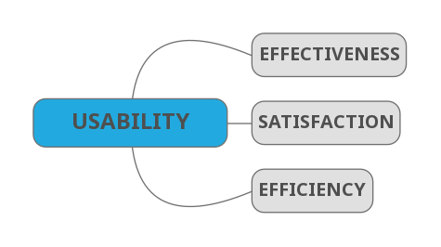
Usability in HCI
Usability in HCI
Usability in Human-Computer Interaction (HCI) refers to the extent to which a system, software, or interface can be used by specified users to achieve specified goals with effectiveness, efficiency, and satisfaction in a specified context of use.

Slide 8

Challenges in HCI
Complexity: Balancing advanced functionality with simplicity of use.
Diversity of users: Designing for users with varying levels of experience and abilities.
Emerging technologies: Addressing new challenges posed by technologies like virtual reality (VR) and augmented reality (AR).

Slide 9
HCI Design Process
4 Major key about HCI design process
Understanding user needs.
Designing interfaces.
Prototyping and testing.
Iterating based on feedback.

Slide 10
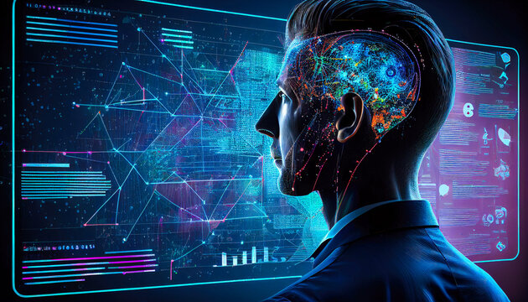
Future Trends of HCI
Top 5 future trends of HCI
1. Natural User Interfaces (NUIs)
2. Augmented Reality (AR) and Virtual Reality (VR)
3. Wearable Devices and Ubiquitous Computing
4. AI and Machine Learning
5. Ethical and Inclusive Design

Slide 11
Conclusion
Human-Computer Interaction (HCI) is the study of how people interact with technology. It aims to make this interaction seamless, intuitive, and enjoyable. By understanding users' needs and behaviors, HCI designs interfaces and systems that are user-friendly and accessible. It focuses on creating technology that aligns with human capabilities and preferences, enhancing the overall user experience.
Thank You

